Slide 1

Honors Classes Spring 2027

Slide 2
Got Questions about Honors?
HONORS WELCOMES STUDENTS FROM ALL MAJORS
HONORS courses FITS IN YOUR GEN EDs & ELECTIVES!
Thinking of transfer, HONORS Courses will prepare you!
Contact Honors Coordinator:
Jessica Hill: honorsprogram@hcc.edu

Slide 3







Honors students are…………………….YOU!
Build Fearless Communication: Do you wanna learn alongside your fellow student?
Active readers: Question everything and everyone? Love to think and read deep?
Thoughtful and Reflective: Making Connections and Why does this Matter?
Critical thinkers: Curious, looking for solutions?
Creative, Risk-taker, or WORK TOWARDS AND Build Confidence?
Committed writers: Ready to continue improving your writing? To challenge yourself and prepares you for TRANSFER, Makes you more competitive for SCHOLARSHIPS!
Members of a learned community: Growing and Becoming part of a group of intellectual scholars
ALL MAJORS WELCOMED and can fulfill ILE REQUIREMENTS for LIBERAL ARTS MAJORS

Slide 4
How To Register for an Honors course:
STEP 1: GO TO YOUR ADVISOR, discuss, AND REVIEW YOUR Degreeworks! ILE courses can fit in GED EDS & Electives. Your advisor can register you!
STEP 2: EMAIL the following people:
First, you are welcomed to email the professor(s) teaching course the Honors course(s) you are interested in.
Second, Honors Program Coordinator (honorsprogram@hcc.edu) and Camille Close (cclose@hcc.edu) with the following information:
Always INCLUDE in your email:
  the number of credits you have taken at HCC
  your overall GPA, Your Major, and you’ve reviewed your Degreeworks
  the CRN of the course you want to take
  your student ID number
  If you do not have the credits OR GPA, please include in email why you are interested in taking this course.
  ALL Register BEFORE add/drop ends due to possible FIN AID Implications
FOR HONORS 206 Captsone course REGISTRATION: Contact Camille Close: cclose@hcc.edu/DON 283
Pathways Program/Senior Program Coordinator

Slide 5
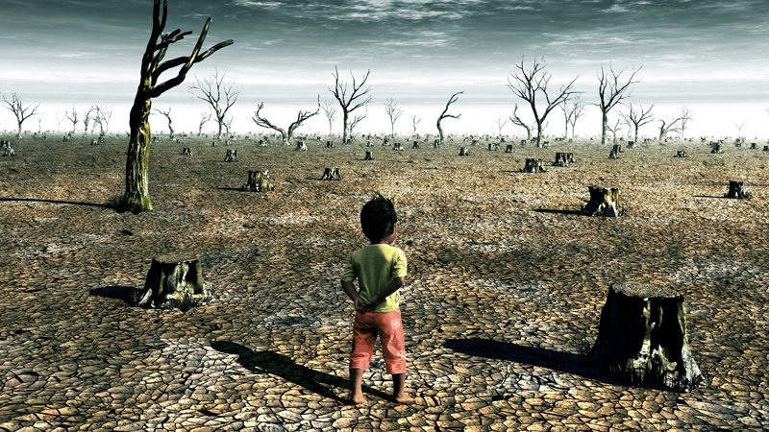
ENG 102.07: Cli-Fi: Science, Speculation, Storytelling (CRN 10827)
This honors section of English 102 focuses on the science of climate change and the new genre of science fiction that has emerged in response. Using Cli-Fi (climate change fiction), this course explores the impact of climate change on the environment, organisms, civilization, and people. Using nonfiction sources and fiction, we will practice close reading, critical thinking, literary analysis, academic writing, research, and the writing process. This course will introduce students to the basics of climate change science as we examine climate change impacts -- environmental degradation, biodiversity and habitat loss, sea-level rise, erosion, extreme weather, drought, and breakdowns in infrastructure and civilization. We will explore the unique power of fiction (and the arts) to help people grapple with climate change.
Note: This section of English 102 has ILE (Integrative Learning Experience) designation, meaning that it provides three ILE credits that apply to the ILE graduation requirement for the Liberal Arts major.
ALL MAJORS WELCOMED-Open Access - This Honors section is open to all students. It provides the opportunity to begin honors work and fulfill graduation requirements for the Commonwealth Honors Program.
Prerequisites: English 101 with a grade of B+ or higher.
Faculty: Professor Elizabeth Trobaugh/etrobaugh@hcc.edu
Cap on Course: 20
Modality: On Campus/In-Person
Meet: TR 9:30-10:45 am

Slide 6

HON 204.01: Ideas that Change the World (CRN 10762)
Ideas that Change the World is a discussion-based Honors Seminar where students examine groundbreaking ideas that have shaped our world. Our primary texts are influential works that raise issues of enduring importance, from justice and colonization to equal rights and the environment. The course concludes with a look at the continuing influence of media on these and other issues. Throughout the course we also explore our own potential for innovation, leadership, and transformative creativity. As an interdisciplinary seminar, this course illuminates ideas that cross the boundaries of several disciplines, including the sciences and the humanities. Just as the world is interdisciplinary, so are the solutions to its most disconcerting problems. Some fundamental questions of our inquiry are: Why do some ideas become influential? What social conditions tend to foster creative thinking? Under what circumstances can creativity transform societies? Across disciplines, what do innovators have in common?
ALL MAJORS WELCOMED-Open Access - This Honors section is open to all students. It provides the opportunity to begin honors work and fulfill graduation requirements for the Commonwealth Honors Program.
Prerequisites: 3.4 GPA, completed ENG 102 with B+ or higher
Cap on course: 20
Faculty: Professor Mary Orisich/morisich@hcc.edu
Modality: on campus/In-Person
Meet: TR 2-3:15pm

Slide 7
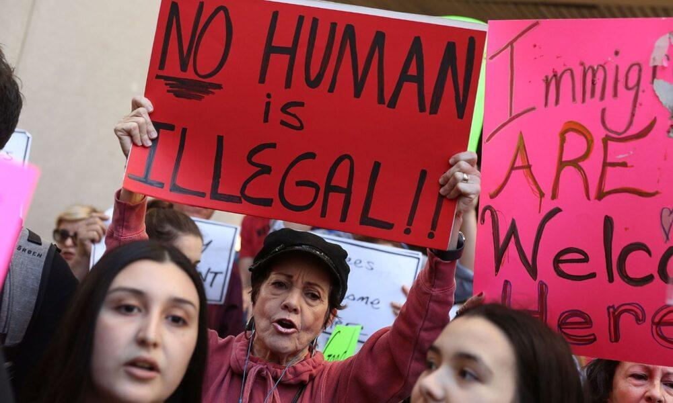
SPA 210.01: “Give me your tired, your poor”: Immigration, identity and the struggle for social justice (CRN 10829)
Almost one in every seven residents in the U.S. was born outside the country and as a result the United States is often called a “Nation of Immigrants”. The “huddled masses” that reach the U.S. come to achieve the ever elusive and non-inclusive “American Dream.” The diverse and a changing cultural and migratory mosaic of the country constantly fuel a partisan political debate, diverting meaningful immigration reform with divisive political rhetoric and policy. This course takes an interdisciplinary journey through U.S. immigration by examining the varied migratory experiences of different ethnic groups—including Europeans, Asians, and especially Latin Americans. We will explore themes such as the power relations inherent in immigration; citizenship, human rights, and sovereignty; racial and intercultural mixture and conflict; nationalism, transnationalism, and internationalism; the opening and closing of borders, immigration enforcement; and the multiple meanings and locations of the concept of “border.” Additionally, we will analyze globalization, economic forces shaping migration, racial dynamics, and gendered dimensions of immigrant experiences. Guiding questions will include: Why do immigrants leave their countries and settle in particular areas of the U.S.? How are they positioned within American racial, ethnic, and class hierarchies—and what consequences arise from this placement?
ALL MAJORS WELCOMED-This Honors section is open to all students. It provides the opportunity to begin honors work and fulfill graduation requirements for the Commonwealth Honors Program
Prerequisites: ENG 101 or prerequisite waiver submitted
Note: This course is taught in English-Includes Community Based Learning
Faculty: Professor: Raul Gutierrez/rgutierrez@hcc.edu
Cap on course: 15
Modality: On Campus/In-Person
Meet: MWF 9-9:50am

Slide 8

HON 206.01: Fast Fashion: Unraveling the Threads of Global Inequality (CRN 10327)
This course will offer an in-depth examination of the fast fashion industry as a microcosm of broader global issues, exploring its intersections with gender, environmental degradation, globalism, capitalism, consumerism, labor rights, modern-day slavery, colonialism, institutional and political power structures. Students will engage in critical examination of ethics and sustainability of the idealized classy, modern way of living. This course will equip students with critical tools to challenge the injustices embedded in the fast fashion industry and inspire them to envision equitable and sustainable alternatives for the future. Ideal for those passionate about social justice, environmental advocacy, and ethical consumption, the course will foster informed global citizenship and transformative action. It will foster knowledge of diversity, encourage critical thinking and collaborative problem-solving, equipping students to become informed advocates for change.
ALL Majors Welcomed!
Prerequisites: 20 credits, completed ENG 101 with B or higher and 3.4 GPA; permission of instructor.
Faculty: Jessica Hill/jhill@hcc.edu & Klara Karol/kkarol@hcc.edu
Cap on course: 15
Modality: On Campus/In-Person
Meet: TR 9:30am-12:15pm

Slide 9

ANT 114.02: From Global Issues to Local Action(CRN 10830)
Did you know that every day 21,000 children die around the world from these silent BUT deadly global issues? How can societies be constructed for the benefit of the majority of its people providing the necessary tools for survival? This course focuses on contemporary global issues as they impact the U.S. and other parts of the world. Students will have on- and/or off-campus curricular and co-curricular experiences that contribute to the understanding of contemporary world issues. As the course progresses, students will learn how to participate in the dialogue surrounding these problems in ways that are informed and credible, and along the way take action to address their chosen social problem with local organizations. This course requires a community-based learning research project in which students will be required to demonstrate global understanding of the impact of global processes at a local level.
All Majors Welcomed!
Open Access - This Honors section is open to all students. It provides the opportunity to begin honors work and fulfill graduation requirements for the Commonwealth Honors Program.
Includes Community Based Learning
Faculty: Vanessa Martinez/vmartinez@hcc.edu
Cap on course: 20
Modality: On campus/In-person
Meet: TR 12:30-1:45 pm

Slide 10
Honors (HON 201) Independent Study 1-3 credits Multi-step process: REGISTRATION BEFORE ADD/DROP DEADLINE
ALL Majors Welcomed!
Missing a credit -or- want to earn CHC requirement? Consider this! No matter what form your project takes, it must be well researched. You will work together with a faculty mentor to create a project. Project topics are limited only by your imagination or ability, the faculty mentor guidelines,and a regard for the degree of academic rigor expected by the HCC Honors Program.
To be eligible for the Honors Project (HON 201), you must:
Have a GPA of 3.5 or the permission of an instructor
If HON 201 is being attached to a course, you must be earning a “B” or better in it. Honors projects may not be attached to 0-level courses , to independent studies , to the Honors Colloquium, to Honors Learning Communities or to ENG 101. All information on www.hcc.edu/honors/honors projects
Contact: Jessica Hill (jhill@hcc.edu), Honors Coordinator
Instructions for the Honors Project Proposal:
1. Discuss Your Interests: with your professor, your advisor, and the Honors Program Coordinator.
2. Select a Mentor: Ask a faculty member to be your mentor. Discuss your project with them and review the submission process to ensure it is timely (before the add/drop deadline due to financial aid requirements).
3. FACULTY: Connect with Jessica before submitting anything in Curriculog.
4. Students Review: Before meeting with your mentor to begin work on your Honors Project Proposal, print and thoroughly read the guidelines for completing an Honors Project. You will also need to print the HON 201: 1-3 Credit Honors Project Proposal form, which can be found at (http://www.hcc.edu/honors) under the "Honors Project" section.
5. Prepare Necessary Forms: Additionally, print copies of the following forms to provide to your faculty mentor: Honors Program Faculty Mentor Form OR review and fill together with the Faculty.
6. Get your Mentor's Signature: Ask your mentor to sign the Faculty Mentor Form.
7. Submit Completed Forms: You must submit all completed forms to the Honors Coordinator before the end of the Spring Semester, by APRIL 30, 2027. All necessary forms can be found at [www.hcc.edu/honors]. Make sure to follow all steps carefully to ensure a smooth process for your Honors Project.
8. Connect with any questions or concerns: Jessica Hill @jhill@hcc.edu/Camille Close @cclose@hcc.edu

Slide 11
Explore your selective transfer options to:
Amherst College
Mount Holyoke
Smith College
Williams College
And beyond!
Schools Participating in the Transfer Scholars Network
Amherst College (MA)
Bowdoin College (ME)
Cornell University (NY)
Massachusetts Institute of Technology (MA)
Mount Holyoke College (MA)
Pomona College (CA)
Princeton University (NJ)
Smith College (MA)
Spelman College (GA)
Swarthmore College (PA)
Williams College (MA)
Yale University (CT)
Connect with Pathways Program:
Pathways wants you to dream big! NEVER TOO EARLY TO TALK TRANSFER!
Pathways Program is a transfer support program that helps promising students the ability to succeed at HCC and explore transfer opportunities to selective liberal arts colleges such as Mount Holyoke, Smith, Amherst, Williams, and others. The program intentionally fosters student relationships utilizing the holistic approach to offer academic and personal support such as advising, workshops, hosting transfer information sessions with selective college representatives, conducting college visits and assists with the transfer process to selective colleges for high-potential students, especially from underrepresented backgrounds. If you love learning, we welcome you to have exploratory conversations about select colleges' transfer admissions processes, majors and course selections, and GPA requirements.
Contact
Camille Close, DON 283
Email: cclose@hcc.edu
Phone: 413.552.2277

