Slide 1
Spring 2027 Learning Communities
What is a Learning Community?
A learning community (LC) is usually a combination of two courses organized around a common theme. The connection between the subject matter in each course is emphasized so that information and skills learned in one of the courses can be applied to the other courses in the learning community. The same students enroll in all the courses in a learning community and the instructors team teach. Students learn collaboratively and assignments are integrated. At the end of the semester, each student gets a grade and credit for each of the courses that are part of the learning community.
Why should I join a Learning Community?
LCs build confidence and skills you will need wherever you go.
LCs help you meet cool, new friends!
LCs give you one-on-one help from TWO professors!
LCs make required courses FUN!
LCs prepare you for any career & transfer!
LCs get you six credits (usually).
ALL MAJORS are welcomed! (FIT IN YOUR GEN EDs. & Electives)

Slide 2
A little bit about the “lingo”...
OL = Fully Online
OC = On Campus
HB = Hybrid (some parts of course OL, some parts OC)

Slide 3

LC 101: What’s Love Got to Do with It?
Understanding Intimate Partner Violence
through Literature and Sociology (6 credits)
Why are some people abusive to their partners? Why might someone stay with an abuser rather than leave? How does being a survivor of domestic violence impact someone? In this course, we will explore intimate partner violence (IPV)/domestic violence through the lens of both sociology and literature. We will look at the influence society has on us, and examine culture, power, society in general, and IPV in particular. What can we learn about IPV from non-fiction and literature? How do race, gender, and class impact IPV? We will look at non-fiction memoir, short stories, poetry, and novels and utilize the tools of literary analysis as well as the sociological approach to gain a better understanding about this complicated topic. Our examination will include discussions about race, gender, class, sexual orientation, transgender/cisgender identity, the educational system, politics, the criminal justice system, the mass media, social media, and more.
Prerequisite: Eligibility to ENG 102
Mahon, ENG 102:TR 9:30-10:45 (OC)
Freese, SOC 110: TR 11:00-12:15 (OC)
CRN 10795 : ENG 102.08
CRN 10796: SOC 110.04
To be registered in this LC you must register in each of its courses individually.
Welcomes students in all majors

Slide 4

LC 102: “…And Justice For All?”: Analyzing Civil Rights, Civil Liberties, and the US Supreme Court (6 credits)
Our LC examines the history of the Supreme Court, Civil Rights, and Civil Liberties in the US. Underlying the LC is an awareness that the Supreme Court and its most seminal, and often controversial, cases have both been shaped by and reflective of the complexities of the nation and its people at vital moments. Students will learn about developments in legal theory and the Constitution as well as the changing definition of citizenry, civil rights, and privacy within the context of US social, political, and judicial history. Among the cases to be examined are: Dred Scott v. Sandford; Plessy v. Ferguson; Korematsu v. United States; Brown v. Board of Education; Miranda v. Arizona; Loving v. Virginia; Roe v. Wade; Texas v. Johnson; Obergefell v. Hodges; and Dobbs v. Jackson Women's Health Organization."
Welcomes students in all majors
Prerequisite: None
Henry, HIS 150: Online (OL)
Orisich, POL 140.60: Online (OL)
CRN 10797 - HIS 150.60
CRN 10798 - POL 140.60
To be registered in this LC you must register in each of its courses individually.

Slide 5
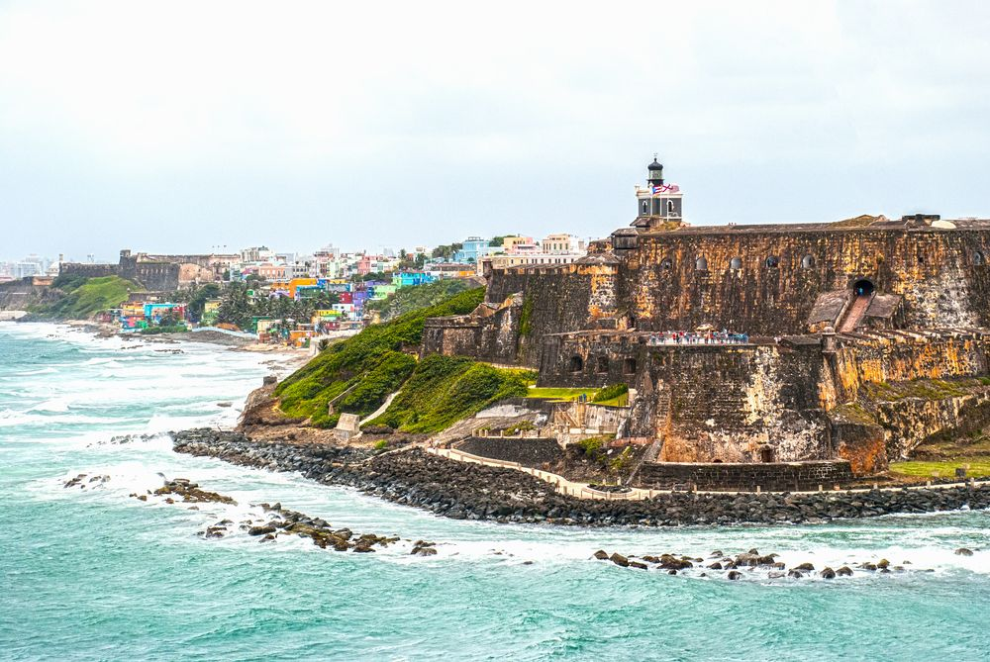
LC 103: Taínos, Creoles, and Boricuas: Caribbean Identities in History and Literature (6 credits)
Puerto Rico is often referred to as “La Isla del Encanto,” or the Island of Enchantment, for its natural beauty and popularity as a vacation spot. Furthermore, this reputation as a carefree zone of sun, sand, and sea extends to the entire Caribbean region. However, behind this fantasy lies a far more complex history of indigenous societies, contact, colonialism, slavery, plantation systems, and migrations that gave birth to the modern Caribbean. In this Learning Community, we will use the lens of history and literature to explore the legacies of colonialism and its effects on current circumstances of the Caribbean region. Through the analysis of historical documents as well as literary texts, students will examine questions of race, ethnicity, gender, class, and religion within the dynamic developments in the Caribbean. Historical documents will provide the necessary framework to understand and interpret both past changes and current circumstances in the Caribbean region. Literary texts will offer ways to question the past and historical representations, address the gaps in the colonial archive, and explore cultural expressions from various groups of people.
Prerequisite Eligibility for ENG 101 (Fluency in Spanish is not required)
López-Cepero, HIS 107:TR 12:30-1:45 (OC)
Gutiérrez, SPA 209: TR 2:00-3:15 (OC)
CRN 10799: HIS 107.07
CRN 10875: SPA 209.01
To be registered in this LC you must register in each of its courses individually.
Welcomes students in all majors

Slide 6

LC 104: Calling Dr. Google: Self-Help Culture in the U.S.
(6 credits)
We've all been there - you feel a strange new symptom and you turn to "Dr. Google" to try to figure it out. Is this a helpful idea? Or does it send you down a late night rabbit hole of fear and worry? What about self-help books that promise improvements, or self-cures for physical and mental health challenges? This course will explore the American obsession with constant self-improvement. We'll look at the good and the bad sides of self-help; and learn how to know when professional help is warranted and important. We'll study and even try out some self-help ideas such as meditation, breathing exercises and more.
Prerequisite: Eligibility to ENG 101
To be registered in this LC you must register in each of its courses individually.
Woody, ENG 101.51: T 6:00-9:00 PM (HB)
Civjan, PSY 110.65: Online (OL)
CRN 10872: ENG 101.51
CRN 10873: PSY 110.65
Welcomes students in all majors

Slide 7
Got Questions?
Feel free to contact Raúl D. Gutiérrez at:
lcprograms@hcc.edu

Slide 8
LCs Are For Everyone!
LCs Are For YOU!

