Slide 1
Federally mandated as the “Voluntary Partnership” for all of manufacturing to develop industry-led standards, assessments and certifications for front-line workers (entry-level through front-line supervisor) for all manufacturing sectors
1998-2001
Background
Notes:
test

Slide 2
2001 Federal Government endorses the MSSC national “Gold” standards involving:
$9+ million public & private funds
4000 front-line workers
Over 700 Companies
300 Experts
Foundation for CPT
Foundation for CLT

Slide 3
Only National Certification Body Accredited under ISO 17024
2000+ MSSC Authorized Assessment Centers
NAM endorsed for Mfg. & Logistics
Given 300,000+ assessments
Issued over 216,000+ credentials
3300+ Authorized CPT & CLT Instructors
50 States + D.C.
MSSC Since
2001 -Today
Notes:
Neil?

Slide 4
The MSSC Credentials
(CPT 4.0, CPT+, & CLT 4.0)
Certified Production Technician (CPT) 4.0: 4 Certificates and full Certification
Safety
Quality Practices & Measurement
Manufacturing Processes & Production
Maintenance Awareness
Certified Production Technician + (CPT+): 4 Hands-on Certificates and full Certification
Safety +
Quality Practices & Measurement +
Processes & Production +
Maintenance +
Certified Logistics Associate CLA 4.0: (Material Handling Foundational)
Global supply chain life cycle, basic terminology, safety, quality, equipment, behavior, teamwork, communication, computers, Industry 4.0 Technologies
Certified Logistics Technician (CLT) 4.0: (Material Handling Mid-technical)
Receiving, storing, ordering, packaging, shipping, inventory control, transportation modes, dispatch, tracking, measurement, metric conversion

Slide 5
The MSSC Credentials cont’d
(CFT & CT-SCA)
Certified Forklift Technician (CFT): Service, Repair, & Maintenance of Forklift Trucks
Supply Chain Automation Technician (CT-SCA): A person who installs, operates, supports, upgrades or maintains the automated material handling equipment & systems that support the supply chain
CT-SCA: 3 Certifications (Avg. 200 hours/E-learning & Hands-on/2 assessments each)
Certification- CTSCA-EM: Equipment Maintenance - Maintaining Equipment/Systems
Certification- CTSCA-ER: Equipment Repair - Installing, Modifying, Troubleshooting and Repairing
Equipment/Systems
Certification- CTSCA-NR: Network Repair - Installing, Modifying, Troubleshooting and Repairing Basic Controllers and Networks

Slide 6
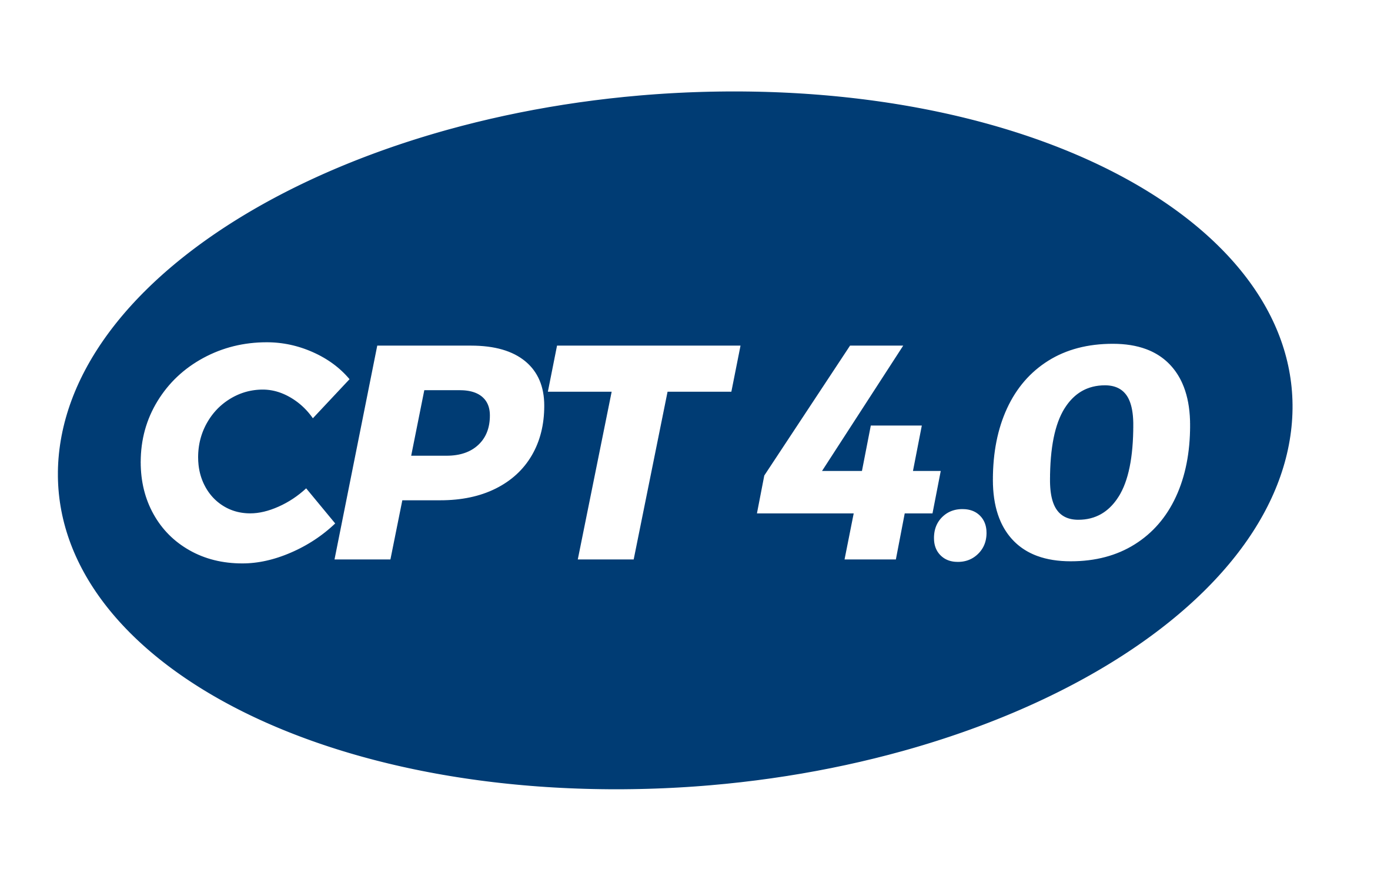
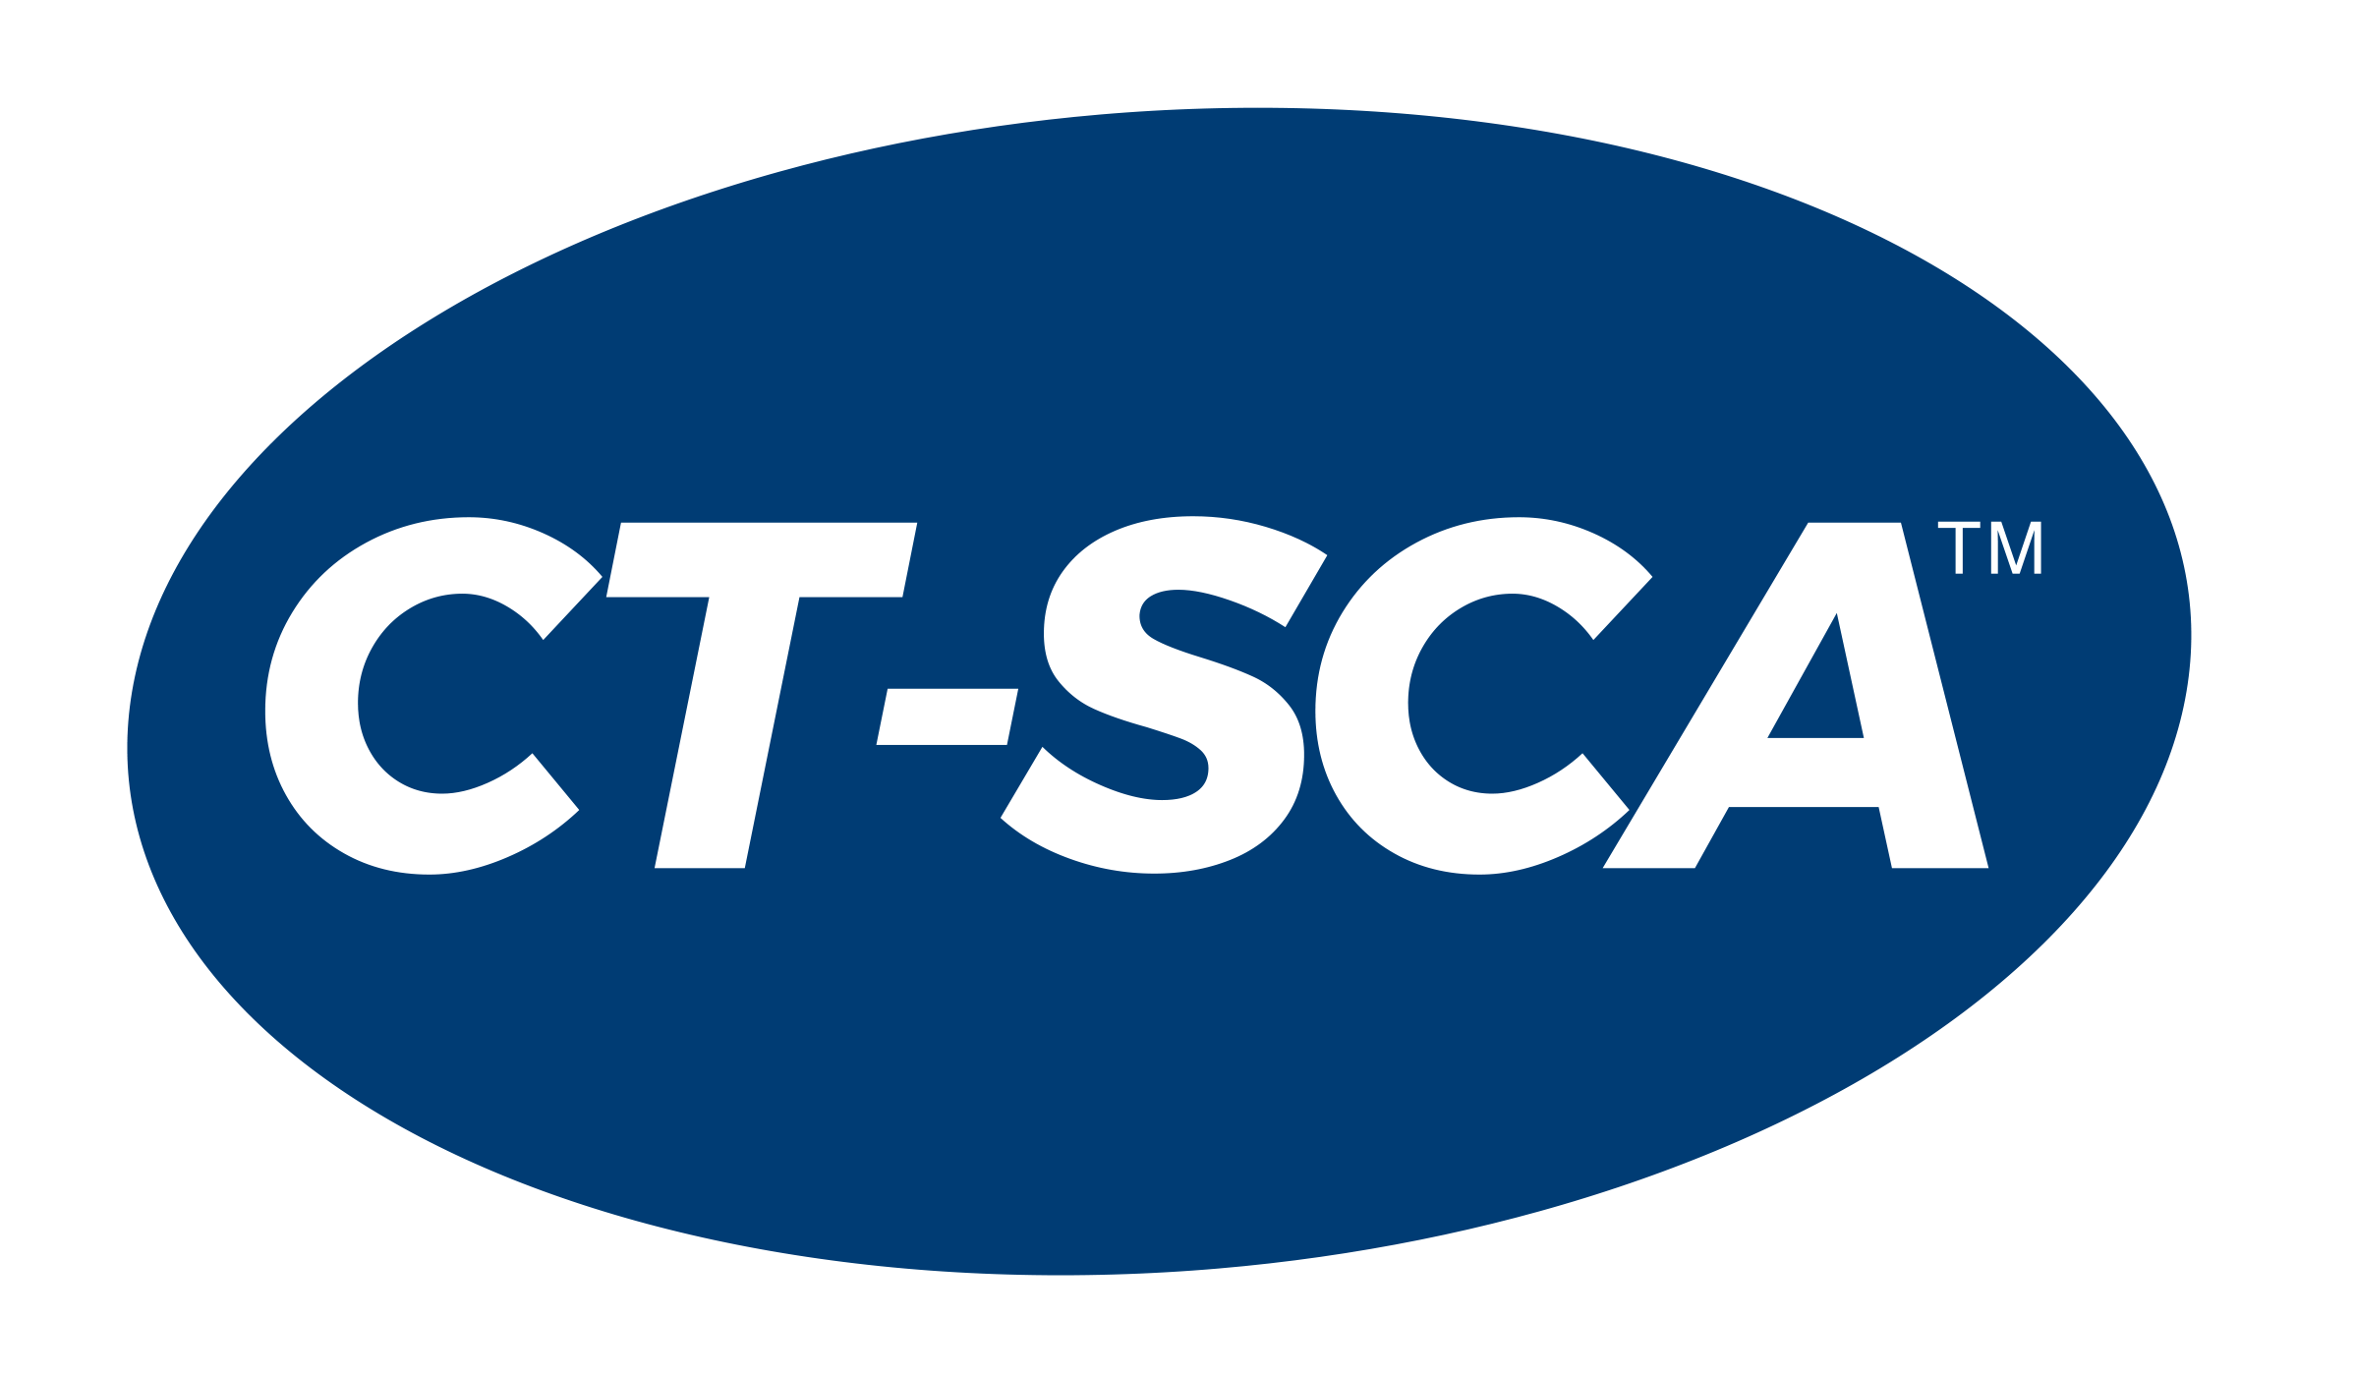
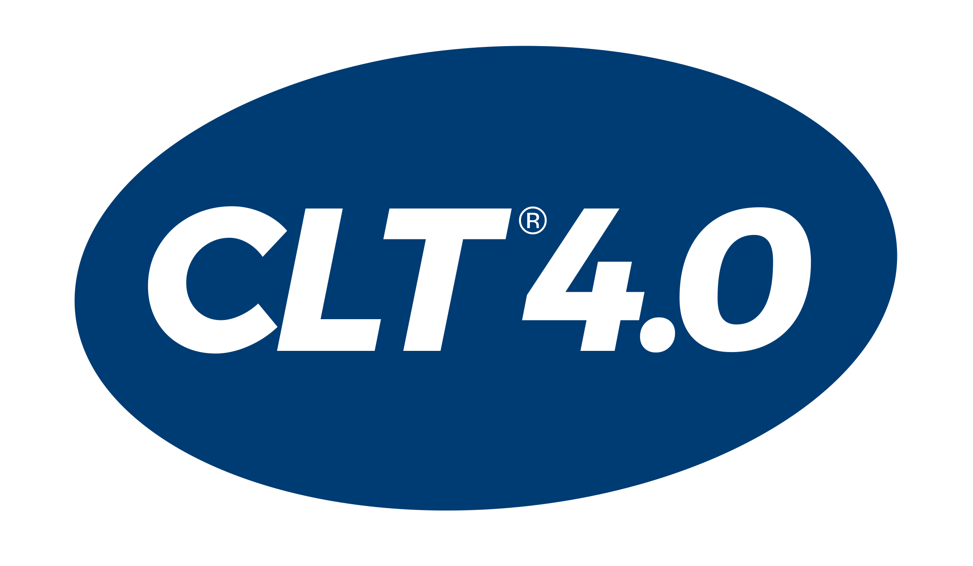
MSSC Certifications
Applicable to broad population
Veterans
Dislocated Workers
Unemployed
Returning Citizens
Students
Incumbent Workers

Slide 7
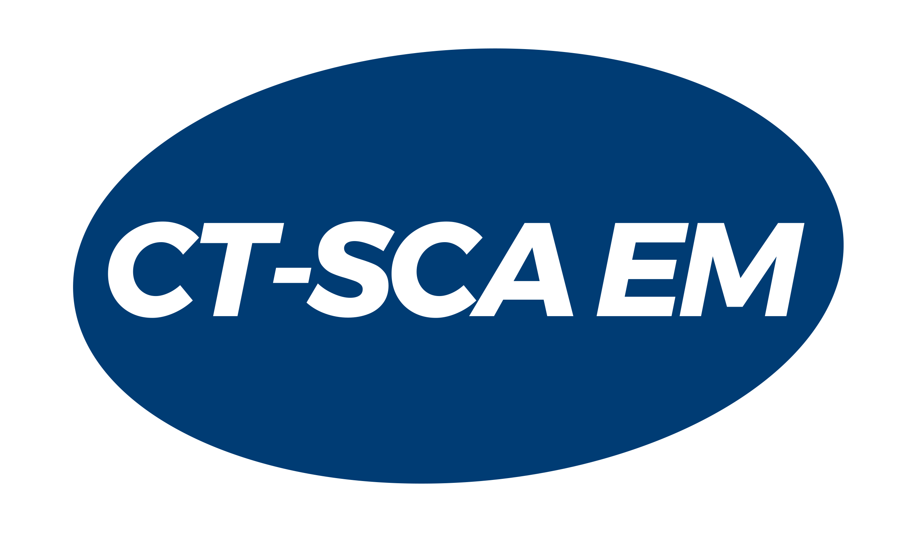
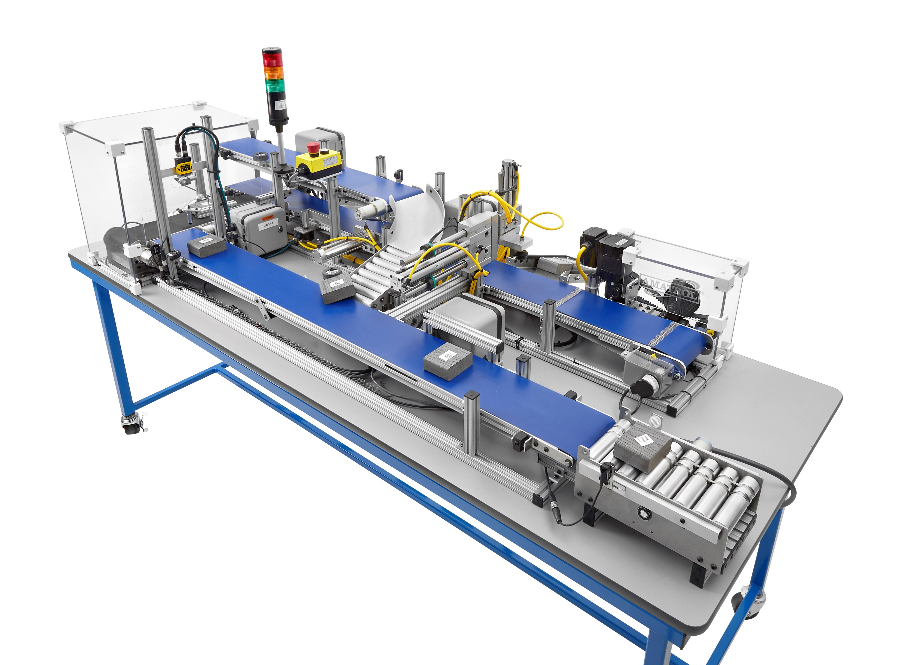
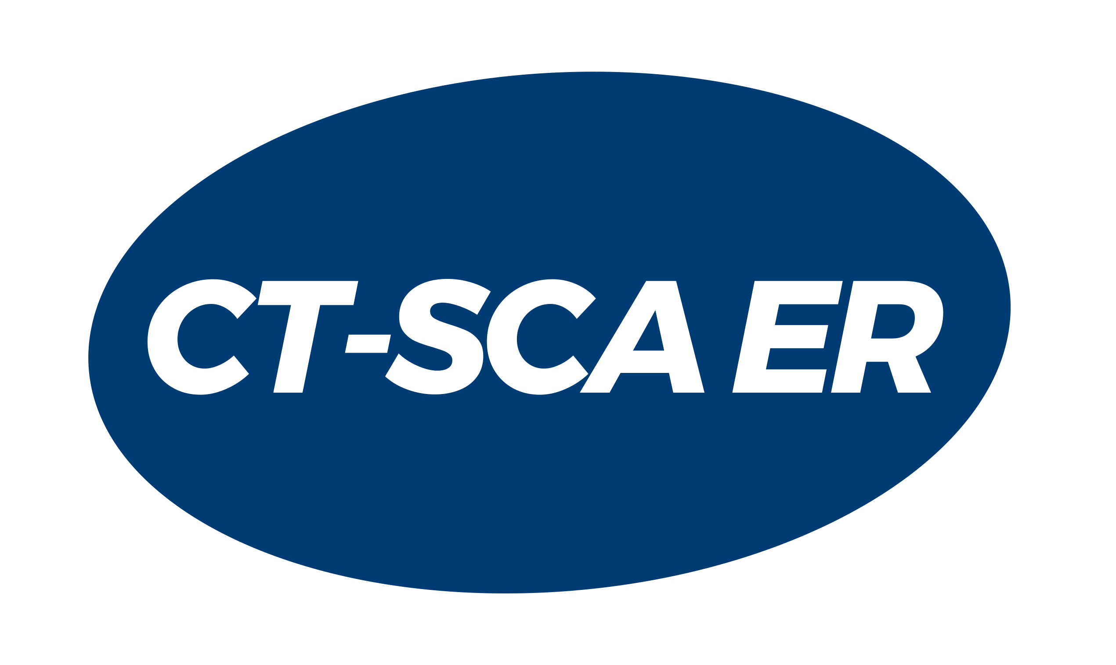
CT-SCA Skill Boss - Logistics
The Certified Technician-Supply Chain Automation (CT-SCA)™ program is specifically designed to prepare technicians for:
Installing
Operating
Supporting
Upgrading
Maintaining
the automated material handling equipment and systems which support the supply chain.
Skill Boss-Logistics draws upon 100 skills from MSSC’s list of industry-defined and nationally validated CT-SCA Standards

Slide 8
Amatrol Skill Boss Logistics – Demo Video

Slide 9
CT-SCA Program Roadmap
National Center for Supply Chain Automation
National Science foundation established the NCSCA (National Center for Supply Chain Automation). The goal of the Center is to increase the number of qualified supply chain technicians to meet the growing national need across the private and public supply chains.
2012
Engaging with Partners
2012 - 2019
Arranged regional stakeholder meetings with national logistic suppliers, technical colleges & state business development groups with an aim to connect businesses with colleges in aligning the need for local technical programs.
Partnership with MSSC & NCSCA
2017
Based off direct input from logistic automation end users, manufactures and key educational partners, MSSC developed a 3-certification system (CT-SCA) for training and testing automation technicians on a national scale.
Partnership with Amatrol
2018
In line with the MSSC CT-SCA standards, Amatrol developed a training and testing machine, Skill Boss Logistics, for technicians to develop the hands-on skills required for this career trajectory.
Buildout of Localized Training Options
2023
Academic institutions and industry partners are now incorporating the Skill Boss CT-SCA system into non-credit, for-credit and incumbent workers

Slide 10
Certified Technician-Supply Chain Automation (CT-SCA): BACKGROUND
Collaboration between NCSCA, MHI, MSSC, Amatrol, MHEDA
CT-SCA: A person who installs, operates, supports, upgrades or maintains the automated material handling equipment & systems that support the supply chain
Comprehensive System:
Industry-defined, nationally validated standards
Courseware
Instructor Training
Assessment
Credentials
Registry

Slide 11
Imbed credentials into pre-apprenticeships and full apprenticeships
WIBs combine unemployment compensation with skills training
State legislation to reward CTE credentials
Veterans Programs
Department of Corrections—CTE for incarcerated = tax payers not tax burdens (DOL Bonding Program)
Successful Implementation

Slide 12
Successful Implementation
Imbed credentialing programs in secondary and post-secondary
For-credit
Credit for Prior Learning
Public & Private Partnerships
Associations/ Chambers
ED Groups
Charity Organizations
Goodwill
Salvation Army
Dual-credit
Non-credit
United Way
Easter Seals
City & State Governments
Industry
Secondary
Post-secondary
WIBs
Competency-based Learning

Slide 13
Contact Information
Tyler Kennedy
Strategic Initiatives Manager, MSSC
E: tkennedy@msscusa.org
T: 703-739-9000 ext. 2226
W: www.msscusa.org
@Manufacturing Skill Standards Council
@MSSCUSA
@MSSCCredentials

Slide 14
Community College of Vermont

Slide 15
Brief
Overview of CCV
Why CPT?
Implementation
Successes
Future
Michael Keogh
Director,
Business Engagement
Workforce Development
Community College of Vermont
Michael.Keogh@ccv.edu

Slide 16
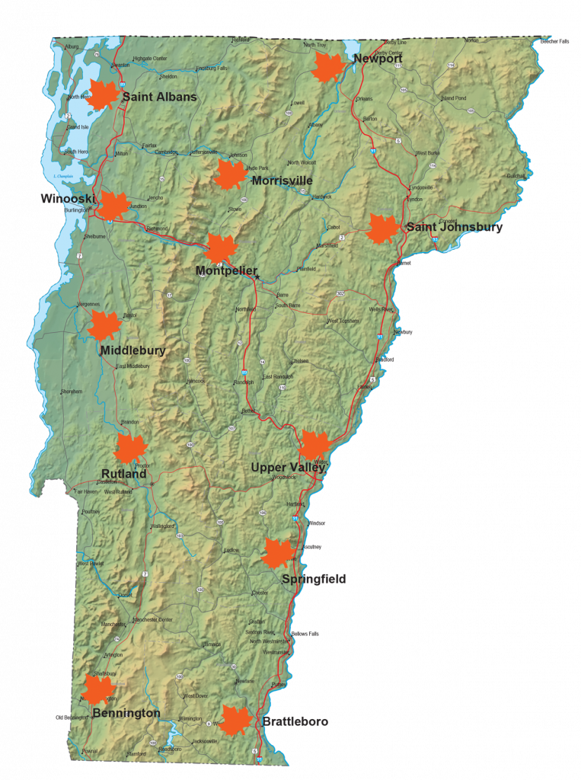
CCV Overview
12 campuses (sole community college)
Vermonters: 93%
Number of students each year: 9,770
~800 Exclusively PT Faculty
Dual Enrollment – Taking courses for college credit while still in high school: 1,871
Degree students with full- or part-time jobs: 79%
First generation: 55%
Graduates (Class of ‘19) who reported being employed, continuing their education, or serving in the military within 6 months: 95%

Slide 17
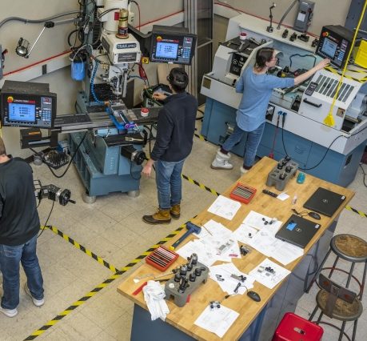
Why CPT?
We’re not a technical college

Slide 18
Why CPT?
We’re not a technical college
We serve a statewide audience

Slide 19
Why CPT?
We’re not a technical college
We serve a statewide audience
Funding
This Photo by Unknown Author is licensed under CC BY-SA

Slide 20
Why CPT?
~45%
of high school graduates have no higher ed aspirations and will be entering the workforce…
*VT DOE
We’re not a technical college
We serve a statewide audience
Funding
Dual Enrollment

Slide 22
Why CPT?
Supervisors
Technical Positions
Production Workers
We’re not a technical college
We serve a statewide audience
Funding
Dual Enrollment
Scale

Slide 23
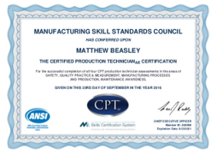
Certified Production Technician Courses
Principles of Manufacturing (3 credits)​
Safety​
Quality Practices & Measurement​
Manufacturing Technology (3 credits)​
Manufacturing Processes & Production​
Maintenance Awareness

Slide 24
Manufacturing Production Technician
Business Involvement
Structured OJT
Related Instruction
Rewards for Skills Gains
Nationally Recognized Credential
Apprenticeship
Manufacturing production technicians set up, test, and adjust manufacturing machinery or equipment, using any combination of electrical, electronic, mechanical, hydraulic, pneumatic, or computer technologies. The median wage for manufacturing production technicians in Vermont is $27.13 per hour. Many of these positions also come with benefits such as paid time off and health care.

Slide 25
Employer Adoption

Slide 26
The Future
Career Pathways
New Manufacturing Certificate Program
Robotics

