Slide 1
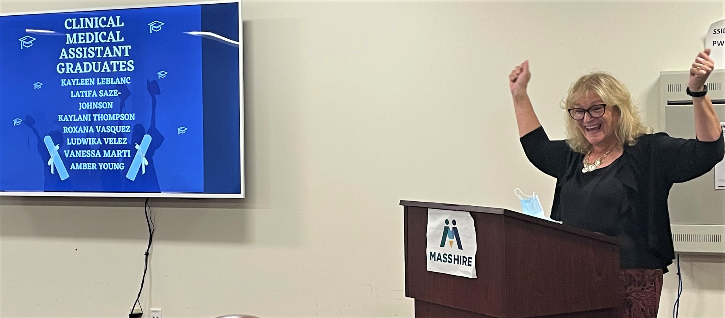
Jobs in Digital Healthcare:
Engaging, Upskilling, Reskilling, & Advocating for Underrepresented and Underserved Demographics
Funded by a $50K JFF/Google grant, three MassHire Workforce Boards researched & developed a plan to expand DEI in the Commonwealth’s Healthcare IT Jobs pipeline in a tech workforce that’s 95% white and 76% male.

Slide 2
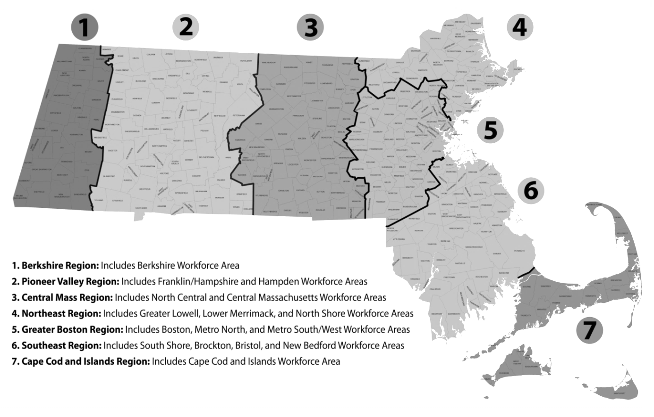



The Playing Field: Geographic Focus & Findings
Healthcare and IT are the fastest growing business & occupational sectors (per LMI & regional blueprints)
Need for qualified IT professionals is growing as healthcare sector expands
‘Digital Divide’ + traditional barriers to participation among target population =
lack of racial & gender diversity in otherwise thriving IT sector
ANALYZING CAREER PATHWAYS MAPS,
WE DISCOVERED…
Many IT jobs don’t require individuals to have a traditional four-year college degree.

Slide 3
HEALTH IT Jobs: You Don’t Have to be a Rocket Scientist!
Data analysis, SQL, Python, Data science, Microsoft Power BI, Tableau, Machine Learning, Data engineering
Database administration, Teradata DBA, Oracle, Salesforce Administration, Salesforce, Project Management, SQL Server, Troubleshooting, Planning, MS Excel, MS Office
Data architecture, SQL, Data Warehousing, Data modeling, data management,
Extraction Transformation and Loading (ETL), Informatics, Machine Learning, AI, Deep Learning, Predictive Models, Neural Networks
Operations Analyst
Median salary: $61,701
# of regional openings: 1,477
Data Engineer
Median salary: $112,397
# of regional openings: 2,172
Education:
1.6% HS
93.3% Bachelor's
3.6% Master's
1.1% Doctorate
Database Architect
Median salary: $110,730
# of regional openings: 1,660
Education:
3.3% HS
2% Associate's
88.7% Bachelor's
4.4% Master's
1.7% Doctorate
Education:
3.5% Associate's
92% Bachelor's
3.3% Master's
1.1% Doctorate
Data / Data Mining Analyst
Median salary: $78,834
# of regional openings: 3,747
Database Administrator
Median salary: $93,331
# of regional openings: 3,334
Data Scientist
Median salary: $113,246
# of regional openings: 2,807
Education:
5.6% HS
2.4% Associate's
83% Bachelor's
6.5% Master's
2.6% Doctorate
Education:
7.1% HS
5.4% Associate's
82.8% Bachelor's
2.5% Master's
2.3% Doctorate
Education:
55.1% Bachelor's
30.3% Master's
14.6% Doctorate
Data Analytics - Greater Boston

Slide 4
Software Development - Greater Boston
Website design/development, JavaScript, Content Management Systems (CMS), UI Design, Project Management (PMP), Adobe Experience Manager, Adobe Suite (Illustrator, Photoshop, etc.)
Java, SQL, Python, Software Development, JavaScript, Front-end Development, Software Engineering, Ruby on Rails, Web development, Troubleshooting
Software development/engineering, Java, Python, SQL, React JavaScript, Linux, User Research, UX Wireframes, Prototyping, UI Design, Interaction Design, Visual Design, Photoshop, Agile Development, CSS, HTML5
Education:
7.7% HS
6% Associate's
82.1% Bachelor's
3.5% Master's
Graphic Designer / Desktop Publisher
Median salary: $54,640
# of regional openings: 1,618
Computer Programmer
Median salary: $87,111
# of regional openings: 2,331
Education:
10.5% HS
3.2% Associate's
76.3% Bachelor's
8% Master's
2% Doctorate
Software Developer / Engineer
Median salary: $105,829
# of regional openings: 42,094
Education:
2.4% HS
92.4% Bachelor's
3% Master's
1.1% Doctorate
Web Designer
Median salary: $63,543
# of regional openings: 222
Web Developer
Median salary: $97,966
# of regional openings: 6,000
UI/UX Designer / Developer
Median salary: $103,928
# of regional openings: 3,071
Education:
4.1% HS
0.8% Associate's
90.3% Bachelor's
3.5% Master's
1.3% Doctorate
Education:
18.6% HS
79.4% Bachelor's
2.1% Master's
Education:
1.8% HS
96.2% Bachelor's
0.7% Master's

Slide 5
CyberSecurity - Greater Boston
Technical Support, IT Support, Help Desk support, MS Active Directory, Hardware & Software Installation and Configuration, Customer Service, Security Operations, Information Security, Surveillance
Business Process/Systems Analyst, SQL, Project Management, Linux, Python, Network Security, InfoSec and Systems, Vulnerability Assessment, Threat Analysis, Information Assurance, Intrusion Detection
Budgeting, Scrum, Scrum Master, Project Planning & Development, Software Development, Atlassian JIRA, Agile Development, Python, Linux, Java, Systems Engineering, Software Engineering, System Design, System Architecture, VMware, MS Azure
Education:
30.1% HS
15.8% Associate's
51.9% Bachelor's
1.6% Master's
0.6% Doctorate
Computer Support Specialist
Median salary: $45,809
# of regional openings: 9,332
Systems Analyst
Median salary: $86,812
# of regional openings: 5,707
Education:
5% HS
3.7% Associate's
88.5% Bachelor's
2.2% Master's
0.7% Doctorate
IT Project Manager
Median salary: $111,857
# of regional openings: 8,069
Education:
5.3% HS
3.1% Associate's
84.5% Bachelor's
6% Master's
1.2% Doctorate
Security Management Specialist
Median salary: $63,590
# of regional openings: 484
Cyber/Info Sec Engineer/Analyst
Median salary: $102,325
# of regional openings: 6,189
Computer Systems Engineer/Architect
Median salary: $108,618
# of regional openings: 6,605
Education:
7.3% HS
1.9% Associate's
85.5% Bachelor's
4% Master's
1.3% Doctorate
Education:
1.6% HS
1.3% Associate's
91% Bachelor's
4.4% Master's
1.7% Doctorate
Education:
16.5% Associate's
79.7% Bachelor's
3.8% Master's

Slide 6
CyberSecurity - Computer & Digital Forensics and InfoSec
Basic familiarity with forensic software: Able to understand and apply industry standard tools and applications such as Splunk, Wireshark, Cellbrite, SystemationXRY, ddc3dd, EnCase; use standard risk assessment tools such as ZenGRC, TRUCE, LogicGate, Nessus Vulnerability Scanner, Burp Suite, etc.
Administer, monitor and troubleshoot security systems to ensure they work properly. Conduct testing on security components such as VPN, firewalls, and instruction detection systems. Able to educate staff on data protection and security systems best practices.
Progressive experience in project management, communication, team building and technical expertise. Able to present new ideas clearly and concisely to co-workers
Penetration Tester
Median salary: $52,000 -$73,000
# of regional openings: 1,400+
Information Security Specialist
Median salary: $75,000 - $82,000
# of regional openings:
Information Security Manager
Median salary: $87,000 - $102,000
# of regional openings:
1-3 years experience in Network Security;
- and/or -
Associate’s/Bachelor’s degree in IT or CS (preferred)
All entry level +
3-5 years experience + Bachelor’s degree in IT or CS (preferred)
5-7 years experience + Bachelor’s degree + Advanced degree in Management (preferred)
Computer & Digital Forensics Analyst
Median salary: $58,000 - $80,000
# of regional openings: 1,400+
Computer & Digital Forensics Specialist
Median salary: $80,000 - $91,000
# of regional openings:
IT Security Manager
Median salary: $89,000 - $103,000
# of regional openings:

Slide 7
LET’S TALK ABOUT IT
Do these career pathway maps align with your local experience/knowledge?
Have you used this or a similar approach to map/develop career pathways in your regions?
How are career pathway maps in general potentially useful/beneficial to job seekers, career counselors, and/or employer partners?
LET’S TALK ABOUT IT

Slide 8
TAKE –AWAYS
Help other organizations help you:
  Identify need/problem employers face; suggest holistic approach(es) to design and implement measurable solutions
  Create/schedule convenings: Invite workforce development pros, training providers, recruiters, policymakers, educators, etc.)
  Support digital jobs strategy by offering suggestions & solutions
Spread & sow knowledge and expertise:
  Maintain library of convenings on shared drive, website, newsletters
  Staff convenings; include in staff job descriptions to ensure priority
  Track data; record and learn from successes and failures
Inform, Influence, & Engage Priority Demographics:
  Collaborating with employers helps workforce development staff understand relevant skills/training needs & improves jobseeker services
  More connections/partners = more opportunities for priority demographics
  Tap motivated partners & robust partnerships to advance your digital jobs strategy:
  Short term: Engage stakeholders quickly and consistently; establish new partnerships; host convenings; share info to the wider network
  Long term: Expand tech opportunities (training, funding, etc.) and promote jobs between Greater Boston and Central MA; connect trainers, job seekers, & businesses
TAKE –AWAYS

