Slide 1

Promoting Innovation While Maintaining Quality
White Mountains Community College is student centered, providing opportunities for success, while enriching lives and communities through quality education and valued partnerships.

Slide 2
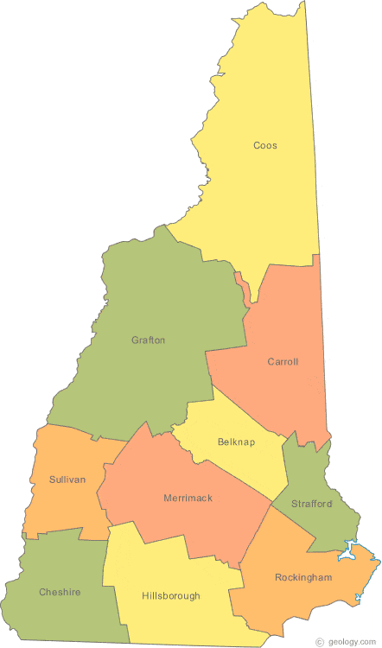


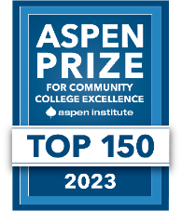



We are Mighty Mountain Movers!

Slide 3



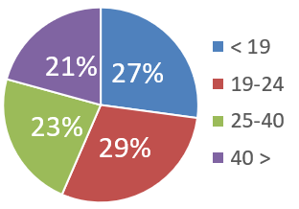
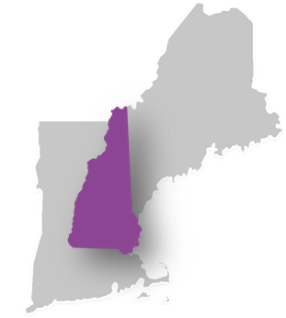





759
Students enrolled for credit
FAST
FACTS
2022
+
247
Non-credit enrollments
Students
70%
Receive financial aid
Average age
28
TOP SENDING
HIGH SCHOOLS
46%
First-generation college students
Berlin
White Mtns Reg
Kennett
Littleton
HiSET/GED
3%
ME
WMCC Magic
7%
VT
3
Locations in northern NH
42
Academic programs
NH
1%
Other
88%
8:1
65%
35%
Student-faculty ratio
69%
Retention rate New England: 57%
1% MA
91%
Classes with < 20 students
Women Men
$215
Per credit

Slide 4

The Ask
Early in 2020 (pre-March) Memorial Hospital asked to partner with WMCC to meet workforce needs for Medical Assistants
The hospital had a critical shortage and was interested in exploring options with the college
Discussions began and the two organizations explored various ways to partner

Slide 5

The Options
Two-year Medical Assistant Associate in Science Degree
Three Semester Medical Assistant Certificate (MAERB Accredited)
10-week DOL Medical Assistant Apprenticeship

Slide 6
The Issues
AS Pathway: Students would not have the proper clinical experience to work or even provide support until end of year two
Certificate Pathway: Students would not be able to enter their internship until their third semester
Apprenticeship: Students did not have enough theory or clinical experience to be successful

Slide 7

The Details
In September of 2020, the group reconvened and developed a project plan
The need for Medical Assistants increased dramatically and the hospital was eager to develop a program, but with quality in mind
The workplan spanned from September 2020 – August of 2021 and included the following elements:

Slide 8
The Details
Program requirements, recruiting, funding
  Review of Maine Health MA competencies
  Complete a gap analysis
  Establish job descriptions, salary range and additional benefits
  Determine schedule of course offerings
  Identify a site contact for Memorial Hospital
  Work with MAERB and CAAHEP for work experience transferability to internship – college to develop policy
  Develop recruiting and onboarding plan
  Develop a detailed budget analysis

Slide 9

The Solution
We went hybrid!
Theoretical and lab foundation of the accredited certificate program
Clinical experience of the on-the-job training
Students complete the 3-semester certificate in two semesters while also providing support during a critical shortage in healthcare

Slide 10

The Solution
Students were compensated at 40 hours a week by Memorial Hospital
Their paid time was distributed between on-the-job training and in the classroom
  16 hours on hospital campus
  16 hours classroom/lab
  8 hours of study time at home
The two semesters worth of on-the-job training completed the third semester internship requirements
Tuition, fees, and books covered by the hospital

Slide 11
The Results
First cohort of 8 students began Fall 2021
All 8 students were retained and completed
All 8 students are still employed after completing
  Primary Care, Orthopedics, inpatient Medical Surgical, Nursing school
New cohort began Fall of 2022
  Compensation model changed, work in progress to return to original compensation plan
Model expanding to Vermont for Fall 2023

Slide 12

Thank you!
Dr. Kristen Miller
Vice President of Academic Affairs
White Mountains Community College
kmiller@ccsnh.edu
603-342-3002
Wmcc.edu

