Slide 1


Aligning Non-Credit and Credit at North Shore Community College
New England Workforce Network Conference 2023
Annie Phillips, Director, Education Strategy Group
Calista Smith, President, Scale Strategic Solutions
Dianne Palter Gill, Dean, Corporate & Professional Education, North Shore Community College
Lori A. Vinci, Dean, Health Professions and Human Services, North Shore Community College

Slide 2

Agenda
  A More Unified Community College Overview
    Treat All Students as Students
    Results from National Student Focus Groups
  A Coaches' Role in Facilitating Non-Credit and Credit Alignment
  North Shore Community College's Priorities for Alignment
    Strategic Priorities for the Institution
    Student Journey Mapping
    Collaboration to More Effectively Serve Learners
  North Shore's Next Steps

Slide 3


A More Unified Community College: Strategies and Resources to Align Non-Credit and Credit Programs is a compilation of research, strategies, and examples of success in the field to support community colleges in pursuit of more equitable student experiences and outcomes. This new resource contains:
  Background on the critical importance of aligning credit and non-credit programming at community colleges
  A new framework that systems and institutions can use to facilitate alignment
  Four different starting points for institutions to begin implementing the framework, each accompanied by a case study highlighting this work in action
  Three distinct Getting Started Guides for institutions and systems; states; and administrators, faculty, and staff

Slide 4
Contributors to the Study
Achieving the Dream
Aspen Institute, College Excellence Program
Association of Community College Trustees
Austin Community College, TX
Blue Ridge Community College, NC
Brookings Institute
California Community Colleges
Capital One Foundation
City University of New York
Community College Research Center
Council for Adult and Experiential Learning
Cuyahoga Community College, OH
Dallas College, TX
Delgado Community College, LA
Florida Department of Education
Georgetown University, Center for Education and the Workforce
Harford Community College, MD
HCM Strategists
Hostos Community College, NY
Ivy Tech Community College, IN
Kentucky Community and Technical College System
Kirkwood Community College, IA
Lane Community College, OR
Louisiana Community and Technical College System
Monroe Community College, NY
National Council of Workforce Education
North Carolina Community College System
North Central State College, OH
Ohio Department of Higher Education
Prince George’s Community College, MD
RAND Corporation
Rural Community College Alliance
Rutgers University, Education and Employment Resource Center
Salt Lake Community College, UT
Sinclair Community College, OH
Tennessee Colleges of Applied Technology
Urban Institute
Virginia Community College System
Washington State Board for Community and Technical Colleges
White Mountains Community College, NH
Yavapi Community College, AZ
‹#›
Notes:
Interviews with 50 postsecondary policy, research, institutional and system leaders
Prioritized geographic diversity
We conducted 5 site visits at Prince George’s Community College, Harford Community College, Monroe Community College, the Kentucky Community and Technical College System and
We’ve also engaged an expert work group, highlighted in red, who have provided in-depth reviewing and strategic guidance
‹#›

Slide 5




Students are struggling to navigate transition between non-credit and credit...
"They appear to be two separate systems"
Credit
Non-Credit
Notes:
It’s complicated
‹#›

Slide 6
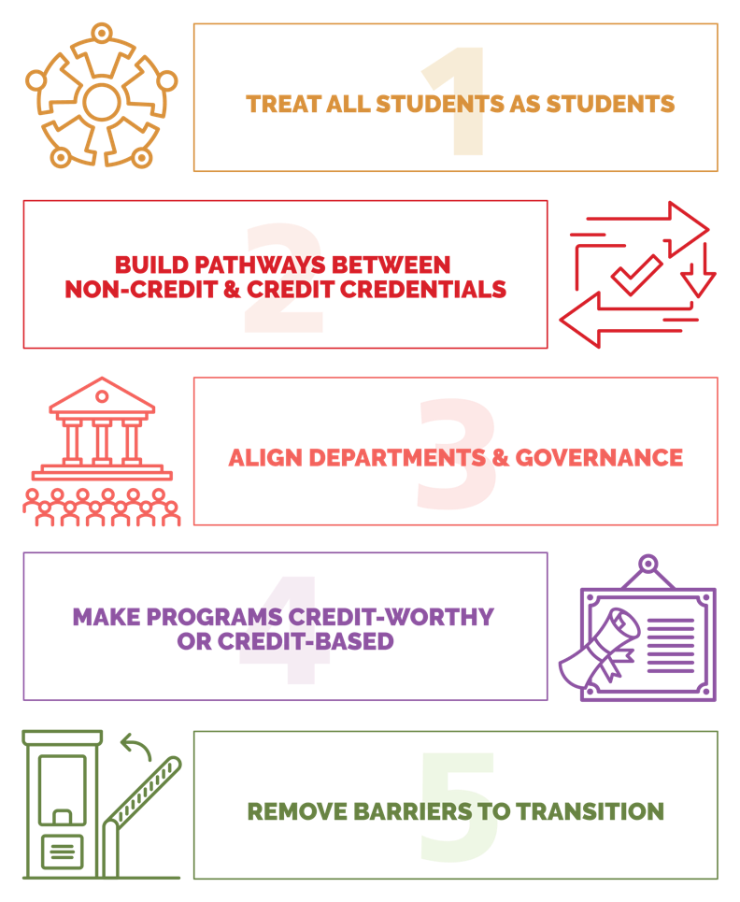
Guiding Framework
Treat all students as students. Treat noncredit students as equal to credit students.
Build clear pathways between non-credit and credit credentials. Promote the next step on the pathway through clear communications and advising.
Align departments and governance. Align operations functions as demonstrated through joint leadership, shared data systems, and/or coordinated processes.
Make programs credit-worthy or credit-based. Provide automatic or partially automatic credit determination for noncredit learning experiences.
Remove barriers to transition. Remove barriers related to finances, financial aid, registration, and others.
‹#›
Notes:
‹#›

Slide 7
NCAL Overview & Objectives
Help 14 leading community colleges across the country embark on efforts to better align their noncredit and credit programming through meaningful spaces to learn and receive support from their peers and national experts.
Set a vision for alignment by leveraging tools available through A More Unified Community College, including the self-assessment survey, case studies and getting started guides.
Increase cross-functional ownership for alignment between noncredit and credit programs through the strategic use of student voice, data and best practice examples.
Begin implementation on their unique visions for alignment which may include:
  Adapting back-end infrastructure to support noncredit to credit transitions
  Embedding noncredit credentials in credit programs, starting with the most in-demand pathways based on student and employer needs.
  Conducting a policy audit to understand the academic and administrative barriers that get in the way of students transitioning and acting to remove the barriers once they emerge
  Developing articulation agreements to ensure all noncredit programs are deemed “credit-worthy”
7
Notes:
Goals and Intent
NCAL is an 18-month initiative (Jan 2022 - Aug 2023) designed to develop new or improved pathways between noncredit and credit programs. Specifically, participating systems and institutions will:
get to full implementation of one high-quality pathway between noncredit and credit programs, and
begin implementation on one additional high-quality pathway between noncredit.
Our goal is that institutions will fulfill these objectives by:
Setting a vision for alignment by leveraging tools available through A More Unified Community College, including the self-assessment survey, case studies and getting started guides.
Increasing cross-functional ownership for alignment between noncredit and credit programs through the strategic use of student voice, data and best practice examples.
Beginning implementation on their unique visions for alignment which may include:
Adapting back-end infrastructure to support noncredit to credit transitions
Embedding noncredit credentials in credit programs, starting with the most in-demand pathways based on student and employer needs.
Conducting a policy audit to understand the academic and administrative barriers that get in the way of students transitioning and acting to remove the barriers once they emerge
Developing articulation agreements to ensure all noncredit programs are deemed “credit-worthy”
ESG and ACCT will guide this cohort through the process by providing a community of practice to learn from each other as each site develops and implements their pathways\
It is our hope that this initiative will lay the foundation for more national attention placed on this issue of alignment between non-credit and credit pathways
ESG and ACCT will also measure, analyze, and disseminate learning from this initiative across the postsecondary and workforce space.

Slide 8





Expectations for Participating Colleges
Meet monthly with your team
Engage in community of practice meetings
Meet monthly with a coach
Collect, share and use data to inform progress
Share your learning and communicate your efforts

Slide 9





This includes getting to know your students
Focus group findings:
Working
adults
Students in non-credit programs want degrees
Parenting
students
80+
“I think the [non-credit] program helped me a lot. I was kind of thinking about starting credit coursework beforehand, but then after I got that diploma in my hand, it really changed things around for me and that’s when I took, you know, a little bit of time to really think about it and then chose my path forward to continue into the degree.”
Learners participated in focus groups
English language
learners
Students
of color

Slide 10

This includes getting to know your students
Focus group findings:
Working
adults
Students in non-credit programs want degrees
Parenting
students
80+
Support services and advising should be responsive to the needs of learners in non-credit programs.
Learners participated in focus groups
“I know the [institution] library has a lot of resources, but I was unable to check anything out… And the librarian said, ‘If you want to check a book out, then you need to be a student, and a continuing education student is not a [institution] student.’”
English language
learners
Students
of color

Slide 11

This includes getting to know your students
Focus group findings:
Working
adults
Students in non-credit programs want degrees
Parenting
students
80+
Support services and advising should be responsive to the needs of learners in non-credit programs.
Learners participated in focus groups
Faculty and instructors have a role to play in student success, too.
English language
learners
"[Professor name] actually helped me from the start – from enrollment to filling out financial aid, everything. So, she’s how I heard about [the degree program]. She said to me, ‘You can do this!’”
Students
of color

Slide 12

This includes getting to know your students
Focus group findings:
Working
adults
Students in non-credit programs want degrees
Parenting
students
"I do have interest in pursuing credit coursework. But like [student] is saying, it’s dependent upon financial aid, and what programs I can afford and potentially get grants for, such as Pell grants or anything like that…”
80+
Support services and advising should be responsive to the needs of learners in non-credit programs.
Learners participated in focus groups
Faculty and instructors have a role to play in student success, too.
English language
learners
Students
of color
Connecting learners to student financial aid—especially grant aid—is critical for non-credit and credit transitions.

Slide 13





Tips for Treating All Students as Students
Make the student experience across non-credit and credit programs more equitable.
Address structural inequities that disadvantage students in non-credit programs over those in credit programs.
Begin to think of students in non-credit programs and students in credit programs as two parts of the whole, which must be considered together.
Ensure every institutional decision or action with student implications includes consideration of students in non- credit programs.
Remove labels attributed to students in non-credit programs.
Credit
Non-Credit
Notes:
It’s complicated
‹#›

Slide 14
NCAL Coaching Support
Connection to National Resources
Strategic Guidance and Organizational Coaching
Centering the Voice of Students: Focus Group Facilitation

Slide 15
Growth Zone
Learning Zone
Fear Zone
Comfort Zone
Focus: Status quo
Focus: Risks
Focus: Lessons and solutions
Build new skills
Focus: Realize goals
Expanded comfort zone
Continuous improvement
Lack confidence
Perceived safety and control
Experience the results/ value
Leverage early adopters and pilots, facilitate trust
Risks and fear are real. Address and move through this zone
Can’t achieve excellence or sustainability in stagnant comfort zone
Illustration: Scale Strategic Solutions
Notes:
11:00 am

Slide 16
Voice of Students
3 Focus Groups, 16 Students
  Recovery Coaching, Community Health, Substance Addiction Counseling, & Drug and Alcohol Rehabilitation
  Machinist
Student Survey about Registration and Student Services Processes

Slide 17
Focus Group Findings
Support services and advising were helpful yet could be made more widely available.
Transition to credit coursework was easier with support from faculty
Students appreciated and desired additional support from staff when navigating administrative processes for non-credit to credit transitions.
Additional communication on non-credit to credit transition is needed.
Students were eager to learn more about credit for prior learning.

Slide 18

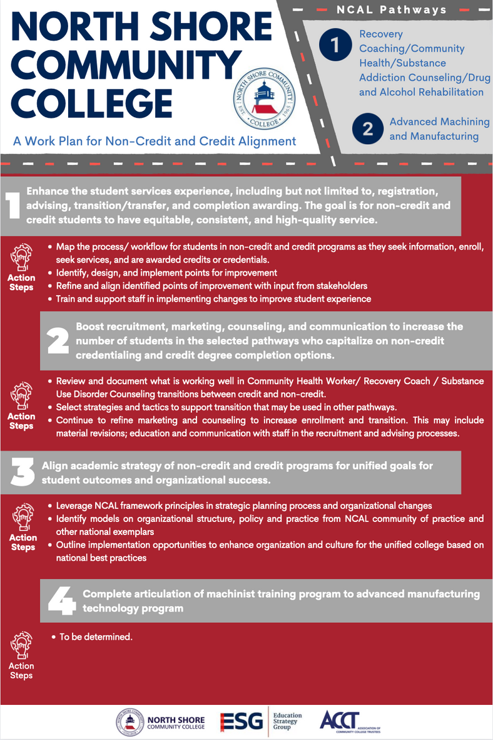



North Shore's Priorities for Alignment
Recovery Coach/Community Health Substance Addiction/ Drug and Alcohol Rehabilitation
Advanced Machining and Manufacturing
Enhance the student services experience
Boost recruitment, marketing, counseling,
& communication
Align academic strategy of non-credit and
credit programs
Complete articulation of machinist training
program to advanced manufacturing

Slide 19
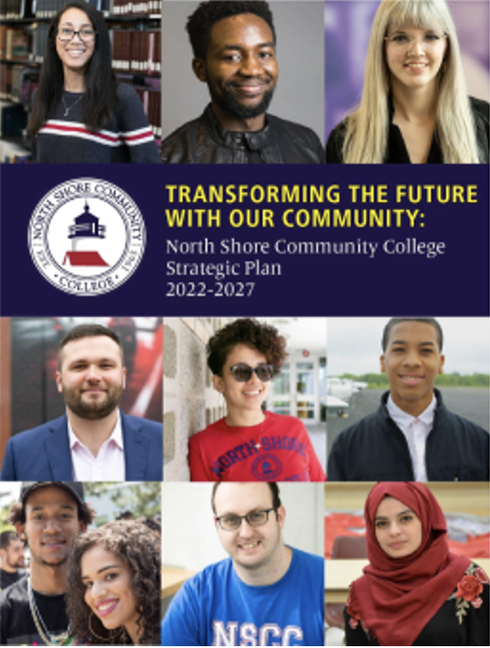
Aligning Priorities to North Shore's Strategic Plan
Priority #1
Align the college with regional needs to spur academic innovation and holistic student support. Align community partnerships to educate the whole student.
Priority #2
Promote social justice at NSCC and in the community by delivering equitable student outcomes.
Priority #3
Build a transformative, future focused environment for the NSCC community.
VISION
An NSCC education consistently leads to excellent and equitable life outcomes for students that in turn improve community outcomes

Slide 20
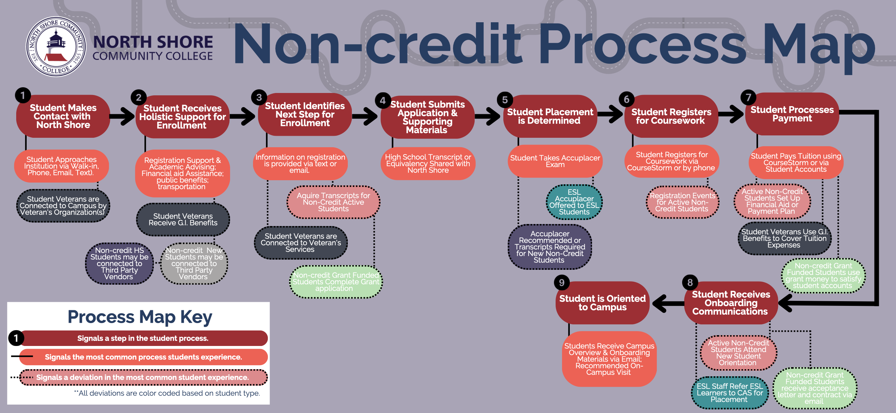
Mapping the Student Journey

Slide 21
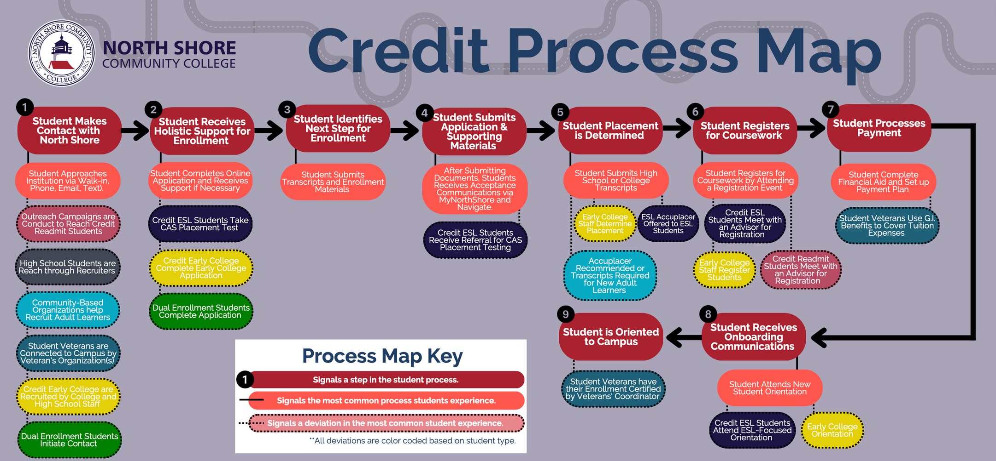
Mapping the Student Journey

Slide 22
North Shore Established Work Groups to More Effectively Serve ALL Learners...
Student Experience Committee
Review student-facing processes to align services to better provide students with non-credit and credit options to meet their education and career goals.
Recruiting and Marketing Committee
Align messaging and tactics to recruit, counsel, and communicate with students so they capitalize on non-credit credentialing and credit degree completion options
Academic Strategy Committee
Design seamless career pathways and articulation processes with robust degree and workforce credential options.

Slide 23



Questions?
Annie Phillips, Director
Education Strategy Group
aphillips@edstrategy.org
Calista Smith, President
Scale Strategic Solutions
chs@scalestrategicsolutions.com
Dianne Palter Gill, Dean
North Shore Community College
dpalterg@northshore.edu

