Slide 1
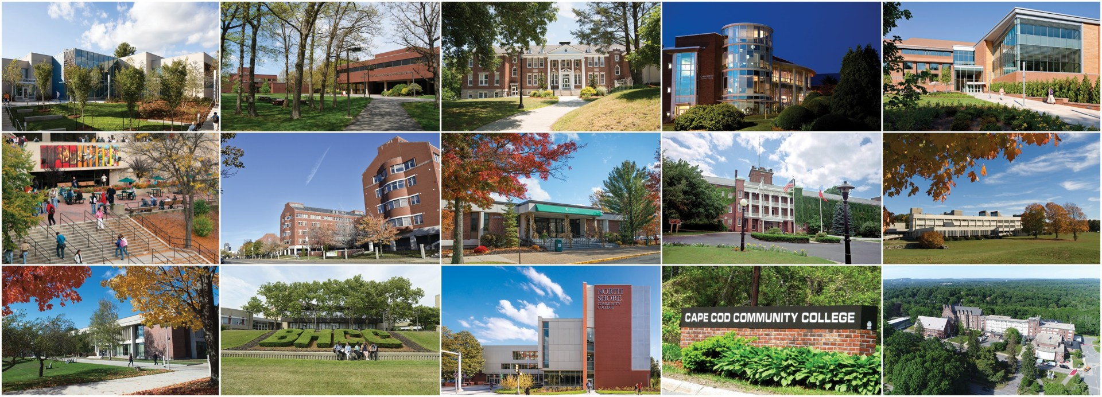
What are the Keys to Being MA Competitive? NEWN Conference - March 2023

Slide 2
Workforce Development Across the State
COLLABORATION
SHARING
IMPROVED ACCESS
Our statewide network of community colleges is an essential resource for training and upskilling new employees into high demand priority occupations throughout the state. Together the 15 community colleges have expansive capacity and demonstrated expertise in design and delivery of hundreds of programs and training opportunities for all learners regardless of age, gender, race, or socio-economic status.
Over the last two years we have shared information and resources, expanded and enhanced the landscape through collaboration and improved access to training and pathway opportunities.

Slide 3
Accessible and Affordable

Slide 4
Creating Pathways
Employer engagement is a strong component in creating a lasting link between education, training and job experience.
Learn and Earn Models
Classroom-based Learning Combined with On-the-Job Training
Employers identified prior to training
Building a systemwide process for awarding credit for work in the field (CNA, Early Childhood, etc)
Retention increases with any experiential learning at the employer of record
According to a 2021 Gallup survey conducted on behalf of Amazon 66 percent of workers ages 18-24 ranked learning new skills as the third-most important perk when evaluating new job opportunities, behind only health insurance and disability benefits.

Slide 5
High Value Placed on Training

Slide 6
Be Mass Competitive Program (BMCP)
BMCP
Specialized Training
Wrap around support services
Stipends for Participants
Job matching and placement
The Massachusetts Association of Community Colleges (MACC), in partnership with the Massachusetts Competitive Partnership (MACP), launched the Be Mass Competitive workforce training initiative in May 2021. Candidates receive specialized training and career-placement services leading to upwardly-mobile employment opportunities at some of the Commonwealth’s largest employers. This program seeks to support and advance the successes of persons of color by providing pathways at MACP companies committed to building a diversified workforce.

Slide 7
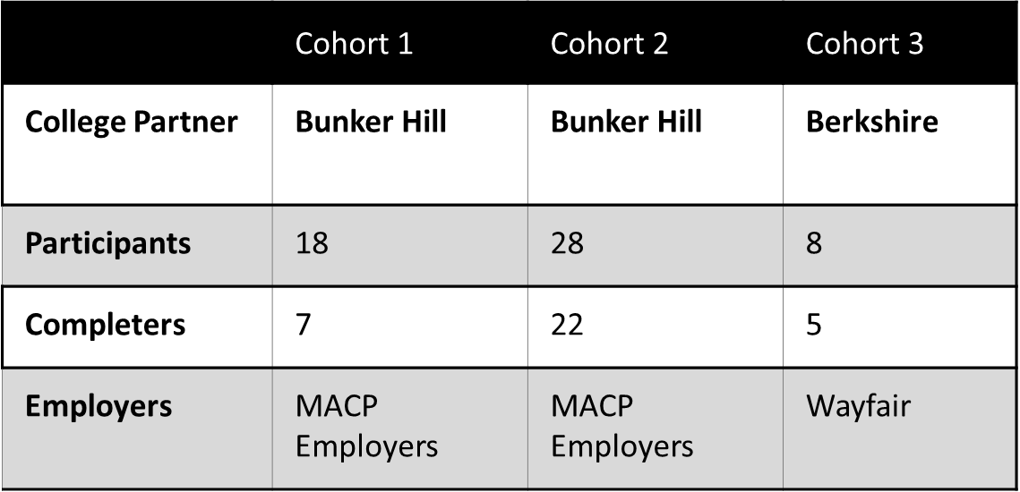
Be Mass Competitive Program (BMCP)
Cohort 4 is currently recruiting for program start in early May at Bunker Hill
Cohort 5 is in the planning phase for a second launch at Wayfair in Pittsfield
FUTURE STATE: Enroll 50 – 100 students per year across 2 cohorts. Expansion to include additional Community College engagement as well as Employer Partners outside MACP Employers

Slide 8
Education and Training Funds (ETF)
The ETF Program is a collaborative effort by MACC, Executive Office of Education, and the 15 Community Colleges to support campus efforts around high-demand workforce trainings. The program will support the creation and expansion of training programs at community colleges for high-demand industries that have been identified by regional labor market blueprints and will utilize a reserve of $15 million spread across all 15 campuses to train/certify/upskill 1,500 MA residents over the course of the 2-year pilot (FY23-24).
Completed | Enrolled | Proposed
314 | 383 | 1400+
Healthcare Real Estate Wilderness IT Education Manufacturing | Healthcare IT Real Estate Cannabis Core Education | 53 unique programs

Slide 9
Education and Training Funds Programming
Healthcare | IT | Business | Other
EMT EKG Tech Phlebotomy Certified Nursing Assistant Pharmacy Tech Recovery Coach Medical Lab Tech Medical Assistant Medical Interpreter Community Health Worker PCA – English and Spanish Direct Care Professional Registered Behavioral Tech Dental Assistant | Network+ PC Network Tech Cisco CCNA Security + Google IT IT Certification Comp TIA A+ Backend Software Developer Frontend Software Developer CAD Design Certification System Support Tech IT Automation (Python) UX Design | Office Support Professional Real Estate Exam Prep Accounting Bookkeeping Exam Prep Data Analytics Digital Marketing and E-Commerce Project Management | Construction Trades HISET Pre-Apprentice Advanced Manufacturing Foundational Manufacturing Hospitality/Culinary 911 Dispatch Dietary Aide Cannabis Core Bartending Paraprofessional Technical Theater Production Technician

Slide 10
Workforce Training Consortium Initiative
The objective in engaging in this consortium work is to establish Community Colleges as leaders in workforce development and serve as key partner to the Workforce Skills Cabinet in delivering workforce training industry credential (non-credit) programs that lead to economic mobility.
Benefits to the Community Colleges:
Scale, simplicity, and impact. Ability for large, multi-year grants
Sharing of resources – one grant writer vs multiple needed for individual grants, etc.
Benefits to Participants:
Fully funded programs that lead to upwardly mobile careers
Expertise in training for high demand careers available throughout the state

Slide 11
Workforce Training Consortium Initiative
Second and Third rounds will expand to other interested campuses and in IT, Paraprofessional and Behavioral Health utilizing a partner school as the Lead on the secondary or tertiary proposals.
Next Steps for Future Focus Areas: Bio-Lab Technician (Middlesex) followed by Industrial Maintenance; Mechatronics Technician

Slide 12
Pipeline Projects and Initiatives
Massachusetts Clean Energy - Offshore Wind, Weatherization Training
Northeast MicroElectronics Hub
Be Mass Competitive Program Expansion
Oracle University
Cybersecurity - Pathways
Accelerate the Future - Mental Health; Peer Counselors
Red Hat Internship
Google
Amazon Web Services

Slide 13
Questions? Lisa Carchia –carchial@macc.mass.edu Carla Abate – abatec@macc.mass.edu

